Slide 1
ITS Infrastructure Services
Integration COE
Knowledge Transfer (1st session)
OpenShift
On 01/04/2020

Slide 2
Objectives
High level overview of the OpenShift platform
How to navigate on the Platform between projects
Permissions / access rights ( full access or read-only )
Access to the OpenShift projects :
SHIFT-UAT namespace on E11 cluster
SHIFT-UAT-MTNC on E21 cluster
SHIFT-DEV, SHIFT-TEST, SHIFT-DEV-MTNC, SHIFT-TEST-MTNC on AWS cluster
Stop pod / Start pod and verification in logs
Core Router: Start the Core Router and check the Logs

Slide 3
Out of scope
Manage OpenShift objects
CI/CD pipeline for OpenShift platform
TIBCO BWCE images
TIBCO BWCE runtime
TIBCO BWCE Monitoring application

Slide 4
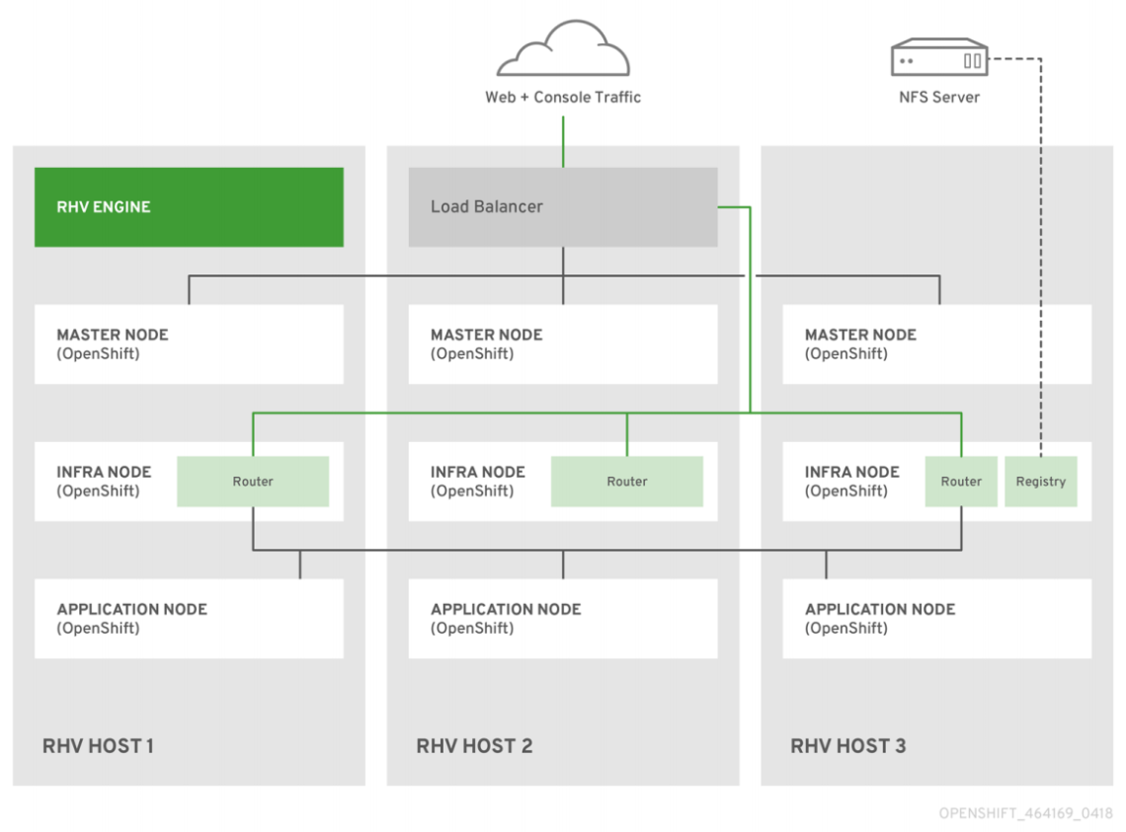
OpenShift overview

Slide 5
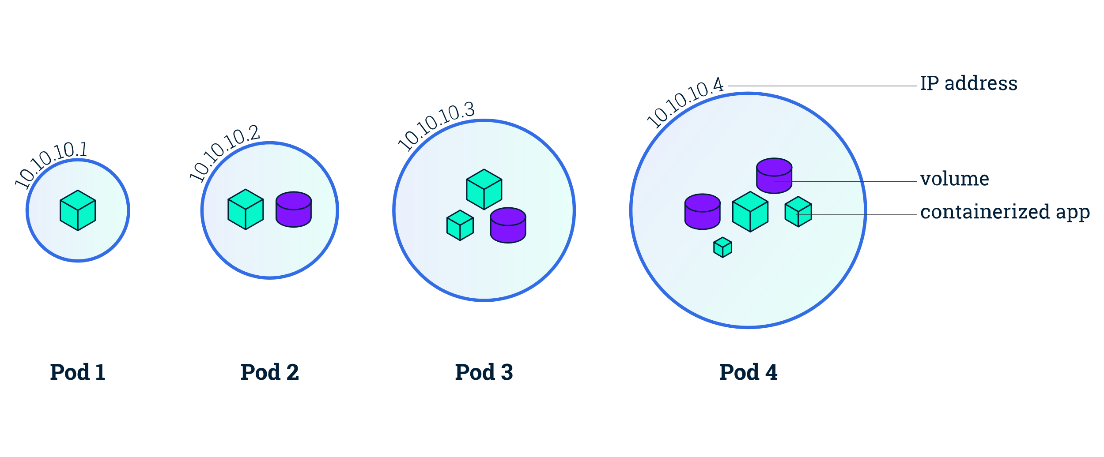
OpenShift pods
A pod is the smallest building block of Kubernetes / Openshift object model
There are two model types of pod you can create :
“one-container-per-pod”
“multi-container-pod.

Slide 6
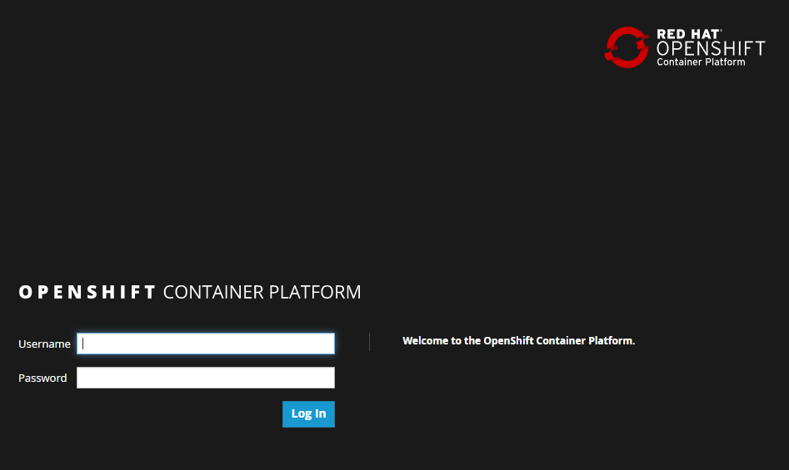
OpenShift E11 cluster
Location : NGDC
URL : https://oscp-e11.scale.sanofi.com:8443/
Projects list :
SHIFT-UAT
TIBCO-COMMON

Slide 7
OpenShift E21 cluster
Location : NGDC
URL : https://oscp-e21.scale.sanofi.com:8443/
Projects list :
TIBCO-COMMON
SHIFT-UAT-MTNC
VEEVAVEDR-(DEV/TEST/UAT/PRD)
1CRM-(DEV/TEST/UAT/PRD)
PROMOMATS-(DEV/TEST/UAT/PRD)
ECOMMERCE-(DEV/TEST/UAT/PRD)
GTT-(DEV/TEST/UAT/PRD)
WEBB-(DEV/TEST/UAT/PRD)
SANETIQ-DEV

Slide 8
OpenShift AWS cluster
Location : AWS
URL : https://scale-portal-eu.service.cloud.local:8443/
Projects list :
TIBCO-COMMON
SHIFT-DEV
SHIFT-TEST
SHIFT-DEV-MTNC
SHIFT-TEST-MTNC

Slide 9
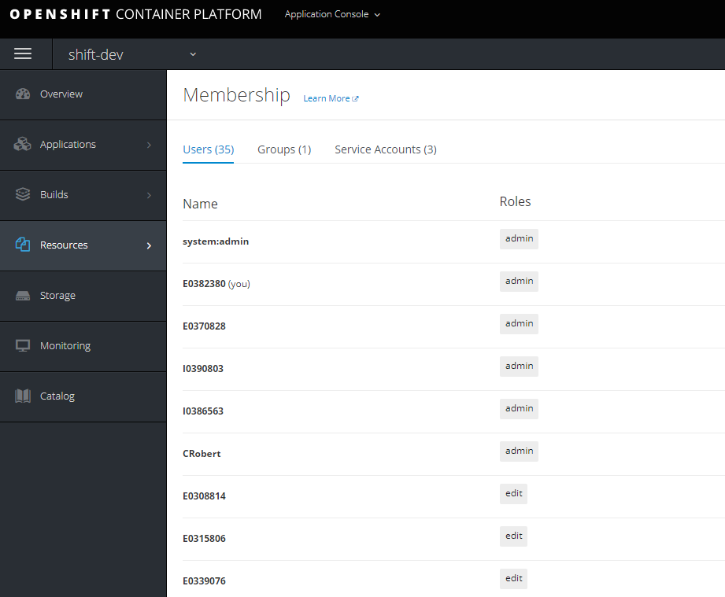
OpenShift project permissions
URL :
<<OpenShiftClusterURL>>/console/project/<<project>>/membership
Example address for SHIFT-DEV project on AWS cluster :
https://scale-portal-eu.service.cloud.local:8443/console/project/shift-dev/membership
Possible build-in permissions :
admin
edit
view

Slide 10
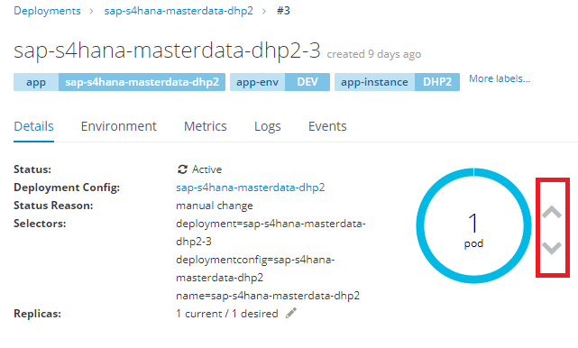
Start & stop components
Address for deployment configuration :
<<OpenShiftClusterURL>>/console/project/<<project>>/browse/dc/<<component name>>
Example address for SHIFT-DEV project on AWS cluster :
https://scale-portal-eu.service.cloud.local:8443/console/project/shift-dev/browse/dc/sap-s4hana-masterdata-dhp2
Start ( scale up to value >0 ) and stop ( scale down to 0 ).

Slide 11
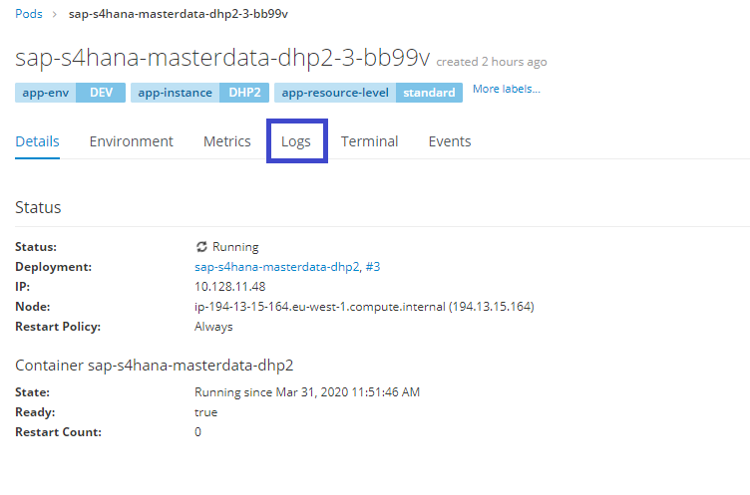
TIBCO BWCE logs
Pod log URL :
<<OpenShiftClusterURL>>/console/project/<<project>>/browse/pods/<<PodName>>?tab=logs
Example address for SHIFT-DEV project on AWS cluster :
https://scale-portal-eu.service.cloud.local:8443/console/project/shift-dev/browse/pods/sap-s4hana-masterdata-dhp2-3-bb99v?tab=logs
Successfully started application log entries :
… BW_PROFILE is set to 'deployed.substvar’ …
…TIBCO-THOR-FRWK-300006: Started BW Application …

Slide 12
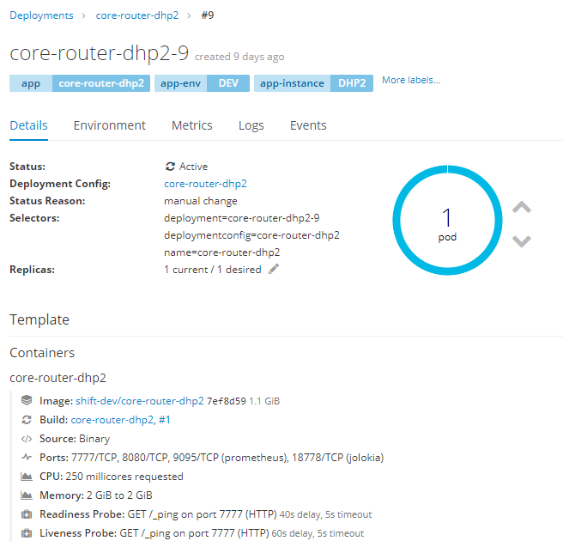
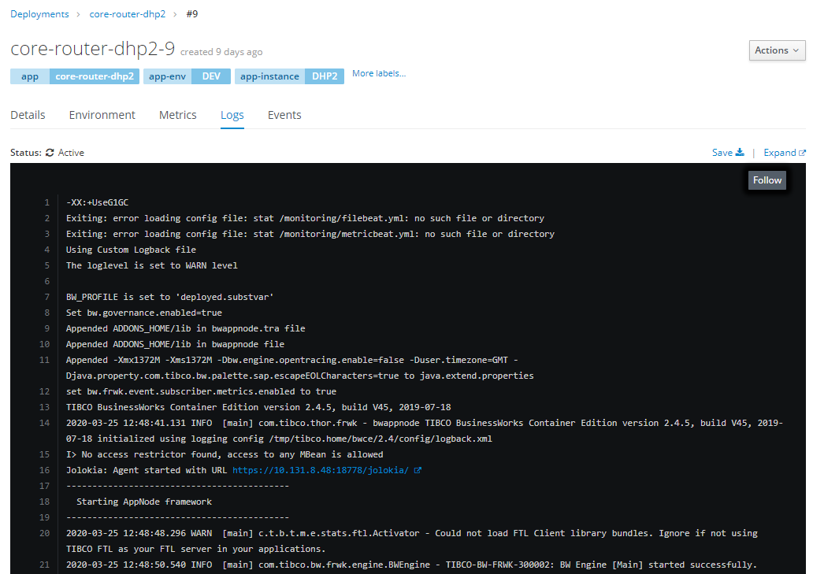
Core-Router
Go to DC list : <<OpenShift cluster URL>>/console/project/<<project name>>/browse/deployments
I.e. for SHIFT-DEV on AWS cluster : https://scale-portal-eu.service.cloud.local:8443/console/project/shift-dev/browse/deployments
Select core-router DC add choose the latest applied configuration.
Scale-up / scale-down as described on „Start & stop components”.
If it’s component start ( scale up ) please verify pods logs to check if everything was successfully started – see „TIBCO BWCE logs” slide for details

Slide 13

Q&A

